Slide 1
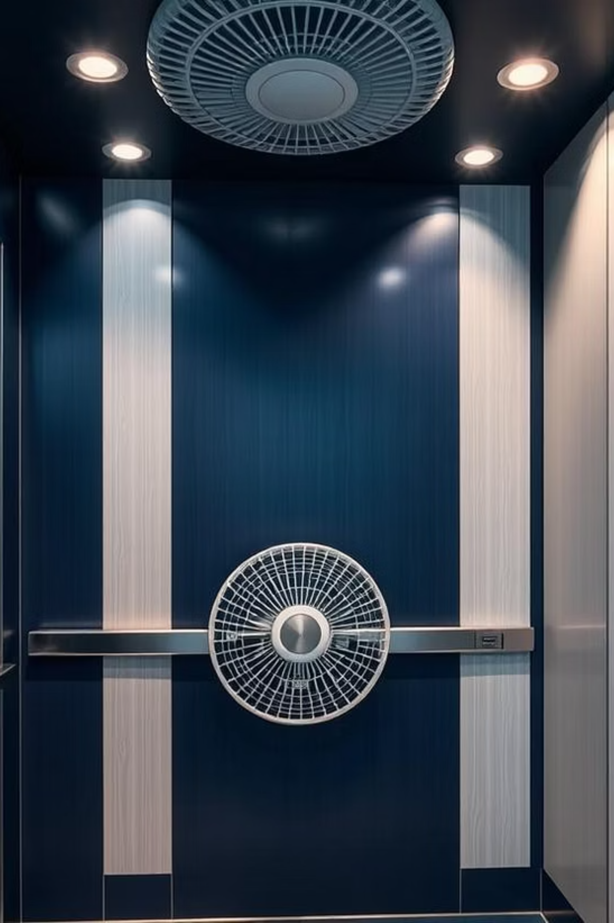
Smart Lift
Fan Control
Automated fan control
using temperature and motion sensors
Presented by :
Team : SolveX
Team Members: Debroop (ECE)
Rahat (EEE)
Fahim (ECE)
Mridha (EEE)

Slide 2
PROJECT INSPIRATION
Lift fans often run unnecessarily, even when the lift is empty or during cold weather.
This results in wasted electricity and reduced fan lifespan.
Rethinking Elevator Comfort and Efficiency

Slide 3



PROJECT STATEMENT
Intelligent Fan Control for Elevators
To design and implement an intelligent system that automatically controls an elevator fan based on real-time temperature and occupancy, ensuring optimal comfort and energy savings for passengers. This system will adapt to seasonal changes and user presence.
Temperature Sensing
Occupancy Detection
Automated Fan Control
Monitors ambient temperature inside the elevator cabin.
Detects presence of people without IR sensors.
Activates/deactivates fan based on pre-set logic.

Slide 4
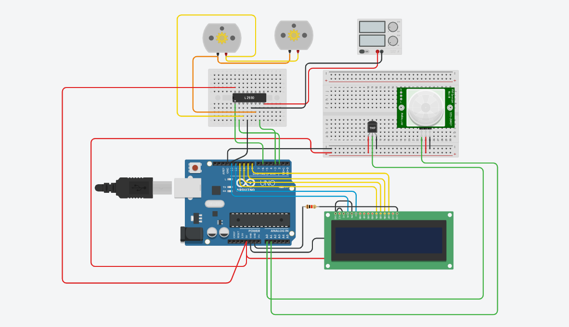
PROJECT OVERVIEW
How the System Works
The system continuously monitors the elevator's internal temperature and detects motion to infer occupancy.
Below 20°C (winter)
Fan off , regardless of occupancy.
Above 30°C (summer)
Fan on, regardless of occupancy.
Between 20-30°C
Fan operates based on motion sensor.
If motion is detected, the fan turns on; otherwise, it turns off.

Slide 5






COMPONENTS USED
Microcontroller (Arduino Uno R3)
Temperature Sensor (TMP36)
The brain of the system, processing sensor data and controlling outputs.
Measures ambient temperature accurately.
PIR Motion Sensor
DC motor (2x) & H-bridge Motor Driver
Detects movement to infer presence of people.
Use as a prototype of fan .
Power Supply
16x2 LCD Display
Use to power the motor driver and Arduino .
Shows the presence of a person and the temperature.

Slide 6

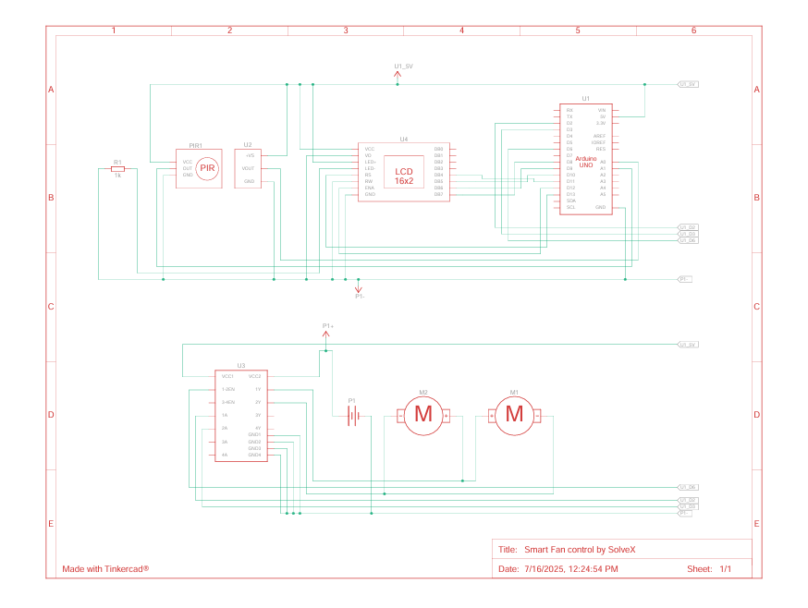
CIRCUIT DIAGRAM
Simplified Circuit Diagram
Schematic Diagram

Slide 7


Code Explanation
The code is structured with an infinite loop that continuously reads sensor data, applies the defined logic, and controls the fan via the relay. Key functions include:
🔧 Pin & Library Setup
• LCD initialized with control/data pins
• TMP36, PIR, and motor driver pins defined
🌡️ Thresholds & Timer
• Fan OFF < 20°C, ON > 30°C
• 3-min run duration after motion

Slide 8
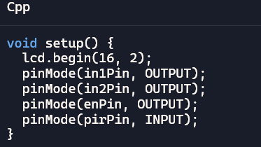
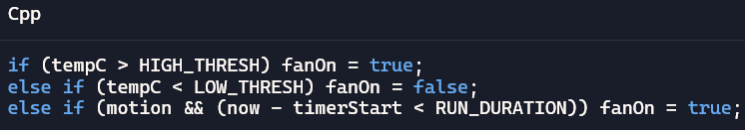
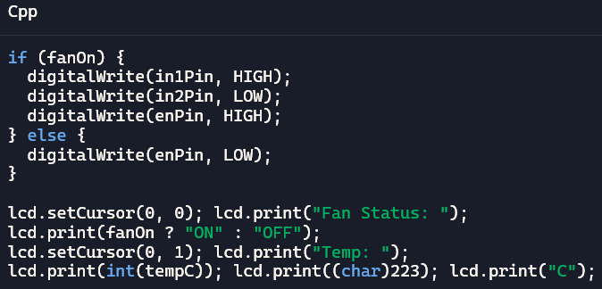

Code Explanation
⚙️ Setup Function
🎛️ Fan Logic
• ON above 30°C, OFF below 20°C
• Motion-based ON within range
• LCD and hardware pins configured
⚡ Motor & LCD
• Fan control via L293D
• LCD displays status & temp
🌡️ Temp Conversion
• Reads sensor value
• Converts to temperature in °C

Slide 9
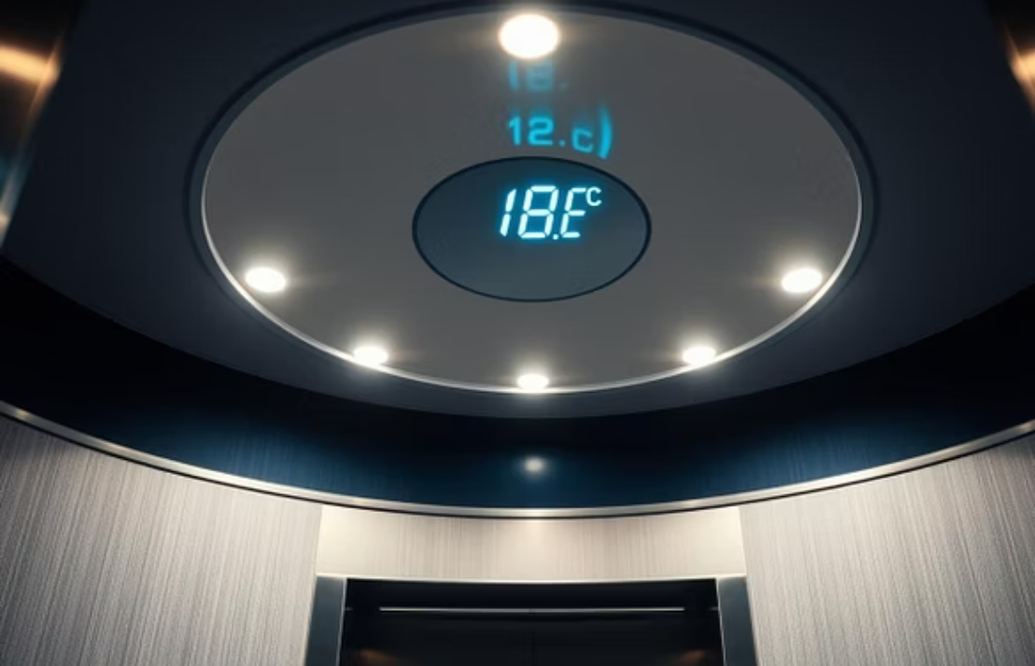
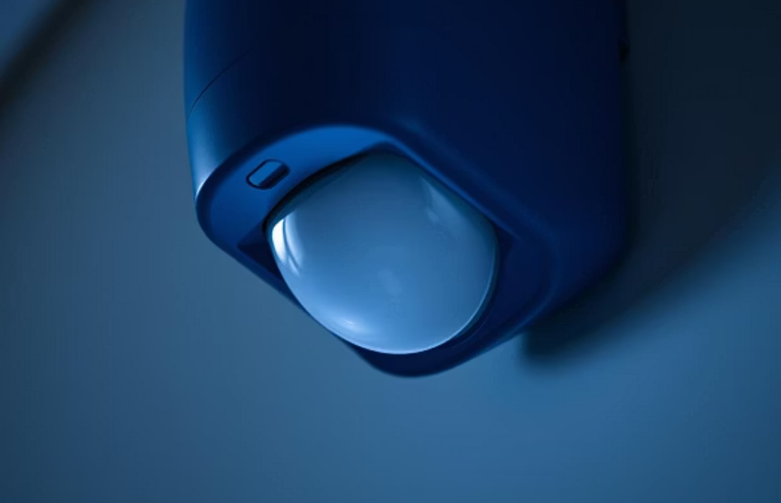

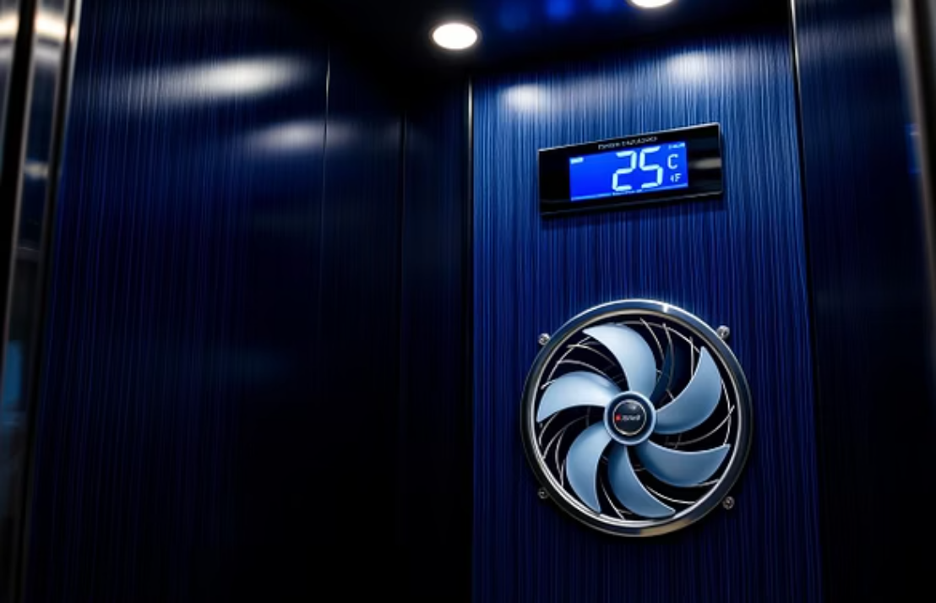
WORKING DEMONSTRATION
Fan activates only when the elevator is occupied
Uses sensors to detect presence and ambient temperature
Automatically adjusts fan operation based on real-time data
Turns off during idle periods or in cool conditions
Demonstrates smart, adaptive temperature control in action
Live System
in Action

Slide 10
CHALLENGES
Challenges Faced
Sensor calibration in varying environments.
Optimizing motion sensor placement for accurate occupancy.
Power management for continuous operation.

Slide 11
FOR FUTURE IMPROVEMENTS
Overcoming Obstacles & Next Steps
Future Improvements
Integrate humidity sensing for enhanced comfort.
Implement predictive algorithms for fan control.
Develop a mobile app for remote monitoring and control.

Slide 12
Thank You
………….

